Slide 1
Avoid overfitting
Train/validation curve
Penalty – L1/L2
Dropout

Slide 2
Data Augmentation
Flip images
Rotate images
Rescale images

Slide 3
Recurrent Neural Networks for NLP
Manish Gupta
Visiting Faculty at ISB
Senior Applied Scientist at Microsoft, India
Adjunct Faculty at IIIT-H
Credits: Stanford CS224D course, CS231N Stanford course, Geoffrey Hinton’s course, http://deeplearning.net/tutorial,
http://colah.github.io/posts/2015-08-Understanding-LSTMs/

Slide 4
Agenda
Motivation for sequence learning models
Introduction to RNNs
RNN application to Image Captioning

Slide 5
Agenda
Motivation for sequence learning models
Introduction to RNNs
RNN application to Image Captioning

Slide 6
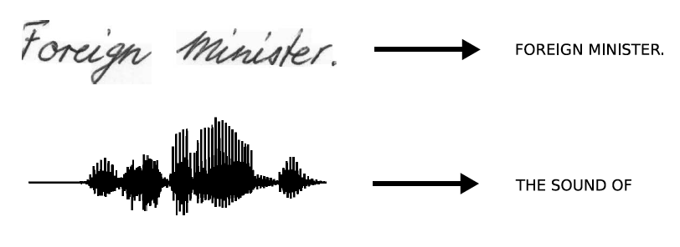
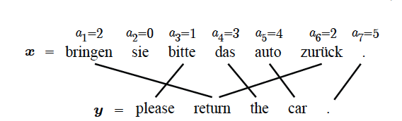
Sequences are everywhere…
We need a way to model such sequence data using neural networks.
Humans don’t start their thinking from scratch every second. As you read this essay, you understand each word based on your understanding of previous words. You don’t throw everything away and start thinking from scratch again. Your thoughts have persistence.
RNNs have loops in them which allow for information to persist.

Slide 7
Language Models
A language model computes a probability for a sequence of words: $P(w_{1},…,w_{m})$
Very useful for many tasks like
Next word prediction
Stocks plunged this morning, despite a cut in interest rates by the Federal Reserve, as Wall ...
Spell checkers
They are leaving in about fifteen minuets to go to her house
Mobile auto-correct
He is trying to fine out.
Speech recognition
Theatre owners say popcorn/unicorn sales have doubled...
Automated essay grading
Machine translation
Word ordering: p(the cat is small) > p(small the is cat)
Word choice: p(walking home after school) > p(walking house after school)

Slide 8
Traditional Language Models
Probability is usually conditioned on a window of n previous words:
$P\left(w_{1},…,w_{m}\right)=Π_{i=1}^{m}P\left(w_{i} | w_{1},…w_{i−1}\right)≈Π_{i=1}^{m}P(w_{i}|w_{i−\left(n−1\right)},…,w_{i−1})$
Markov assumption
To estimate probabilities, compute for unigrams and bigrams (conditioning on one/two previous word(s):
Bigram models: $p\left(w_{2} | w_{1}\right)=\frac{count\left(w_{1},w_{2}\right)}{count\left(w_{1}\right)}$
Trigram models: $p\left(w_{3} | w_{1}{,w}_{2}\right)=\frac{count\left(w_{1}, w_{2}, w_{3}\right)}{count\left(w_{1}, w_{2}\right)}$

Slide 9
Traditional Language Models
Performance improves as n for n-grams increases, and doing smoothing and backoff (e.g. if 4-gram not found, try 3-gram, etc).
There are A LOT of n-grams!
Gigantic RAM requirements!
Scalable Modified Kneser-Ney Language Model Estimation by Heafield et al. ACL 2013: “Using one machine with 140 GB RAM for 2.8 days, we built an unpruned model on 126 billion tokens”
In some cases the window of past consecutive n words may not be sufficient to capture the context.
For instance, consider a case where an article discusses the history of Spain and France and somewhere later in the text, it reads "The two countries went on a battle"; clearly the information presented in this sentence alone is not sufficient to identify the name of the two countries.

Slide 10
Word vector representations
One hot encoding
Word2vec
GloVe
fastText
ELMo

Slide 11
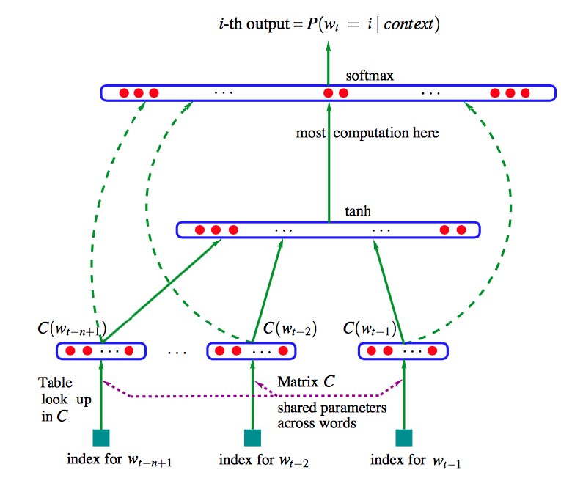
Original Neural Language Model using MLPs
Predict the $i^{th}$ word based on a fixed size context.
In all conventional language models, the memory requirements of the system grows exponentially with the window size n making it nearly impossible to model large word windows without running out of memory.
Problem: Fixed window of context (i.e., n)
Can there be a model which can handle contexts of different length?

Slide 12
Agenda
Motivation for sequence learning models
Introduction to RNNs
RNN application to Image Captioning

Slide 13
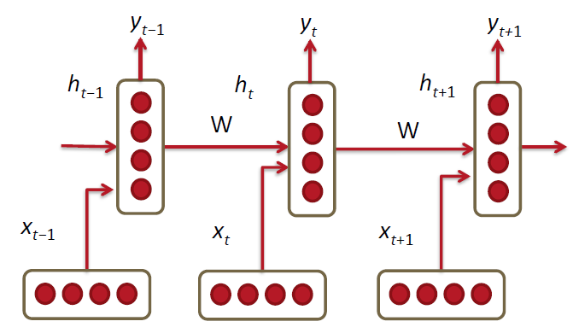
Recurrent Neural Networks!
RNNs tie the weights at each time step.
Condition the neural network on all previous words.
RAM requirement only scales with the number of words.

Slide 14
RNNs
RNNs are called recurrent because they perform same task for every element of a sequence.
Only thing that differs is the input at each time step.
Output is dependent on previous computations.
RNNs can be seen as an NN having “memory” about what has been calculated so far.

Slide 15
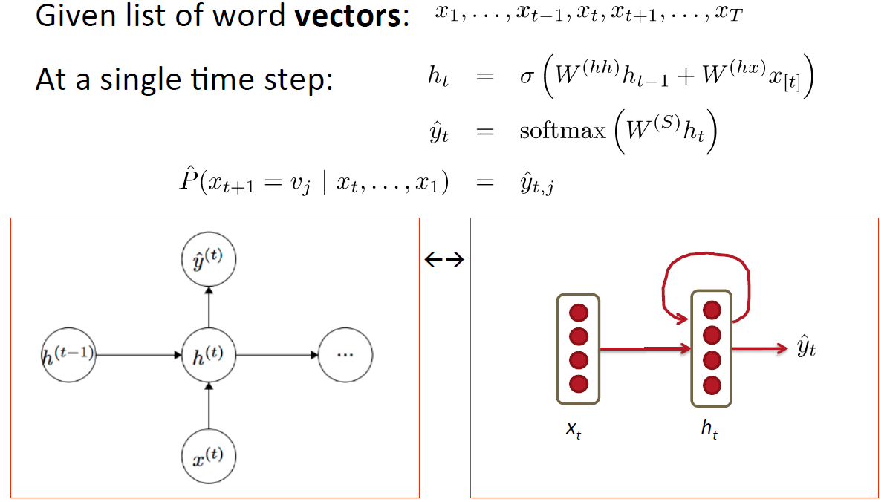
RNN Language Model

Slide 16
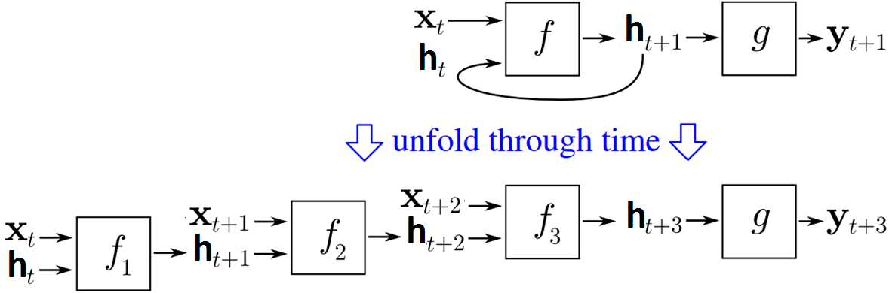
Recurrent NN unfolds into a DNN over time
Condition the neural network on all previous words and tie the weights at each time step.
X_{t+2}
U
V
… …
X_{t+1}
W
h_{t+3}
y_{t+3}
U
x_{t}
$x_{t}$ input at time t
$h_{t}$ memory (state) at time t
$y_{t}$ output at time t
W
h_{t+2}
U
$z_{t}=Ux_{t}+Wh_{t−1}$
$h_{t}=f(z_{t})$
$y_{t}=g(Vh_{t})$
where
f$\left(z\right)=\frac{1}{1+exp⁡(−z)}, g\left(z_{m}\right)=\frac{\exp{(z_{m})}}{\sum_{k}{\exp{(z_{k})}}}$
W
h_{t+1}
h_{t}
Notes:
BPTT

Slide 17
Back propagation through time (BPTT)
Back_Propagation_Through_Time(x, y) // x[t] is the input at time t. y[t] is the output
Unfold the network to contain k instances of f
do until stopping criteria is met:
h = the zero-magnitude vector; // h is the current context
for t from 0 to n - 1 // t is time. n is the length of the training sequence
Set the network inputs to h, x[t], x[t+1], ..., x[t+k-1]
p = forward-propagate the inputs over the whole unfolded network
e = y[t+k] - p; // error = target - prediction
Back-propagate the error, e, back across the whole unfolded network
Update all the weights in the network
Average the weights in each instance of f together, so that each f is identical
h = f(h); // compute the context for the next time-step
Truncated BPTT is an approximation of full BPTT that is preferred for long sequences, since full BPTT’s forward/backward cost per parameter update becomes very high over many time steps.
The downside is that the gradient can only flow back so far due to that truncation, so the network can’t learn dependencies that are as long as in full BPTT.

Slide 18
Recurrent Neural Networks Loss Computation
$\hat{y}=R^{\left|V\right|}$ is a probability distribution over the vocabulary.
Cross entropy loss function can be used for predicting words.
$J^{\left(t\right)}\left(θ\right)=−\sum_{j=1}^{\left|V\right|}{y_{t,j}\log{{\hat{y}}_{t,j}}}$
Over a dataset of $T$ words
$J=−\frac{1}{T}\sum_{t=1}^{T}{\sum_{j=1}^{\left|V\right|}{y_{t,j}\log{{\hat{y}}_{t,j}}}}$
Lower this value the better.

Slide 19
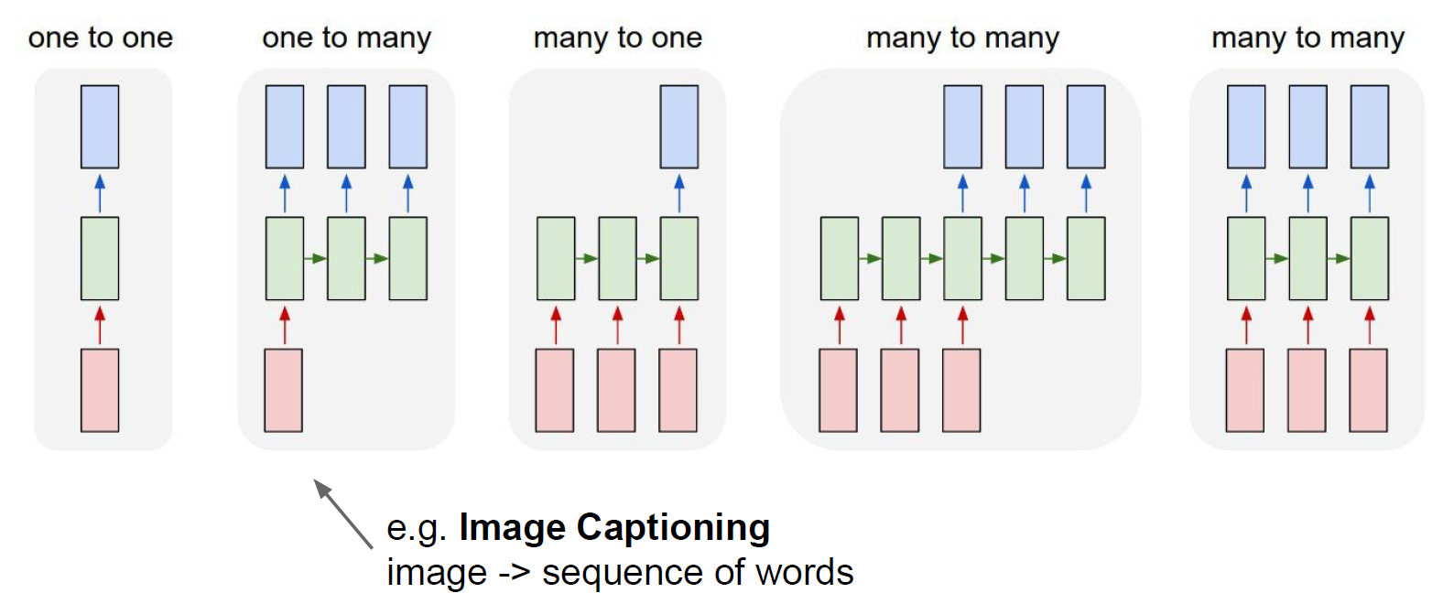
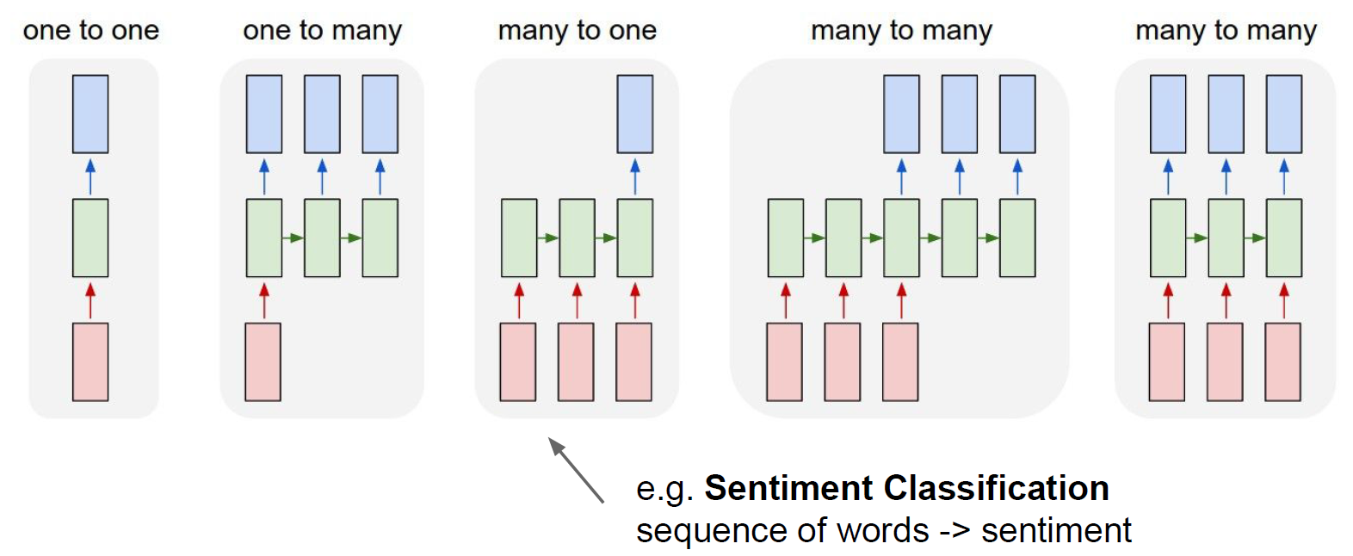
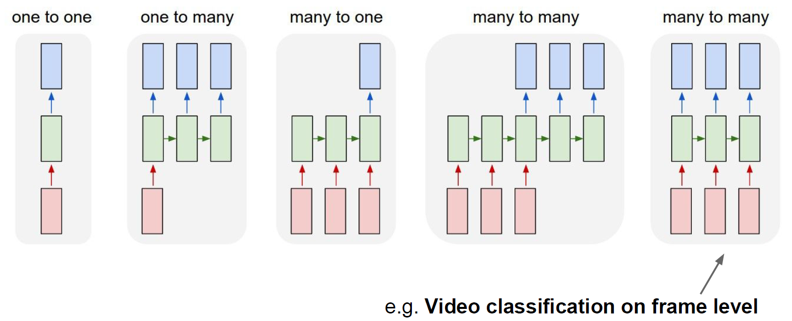
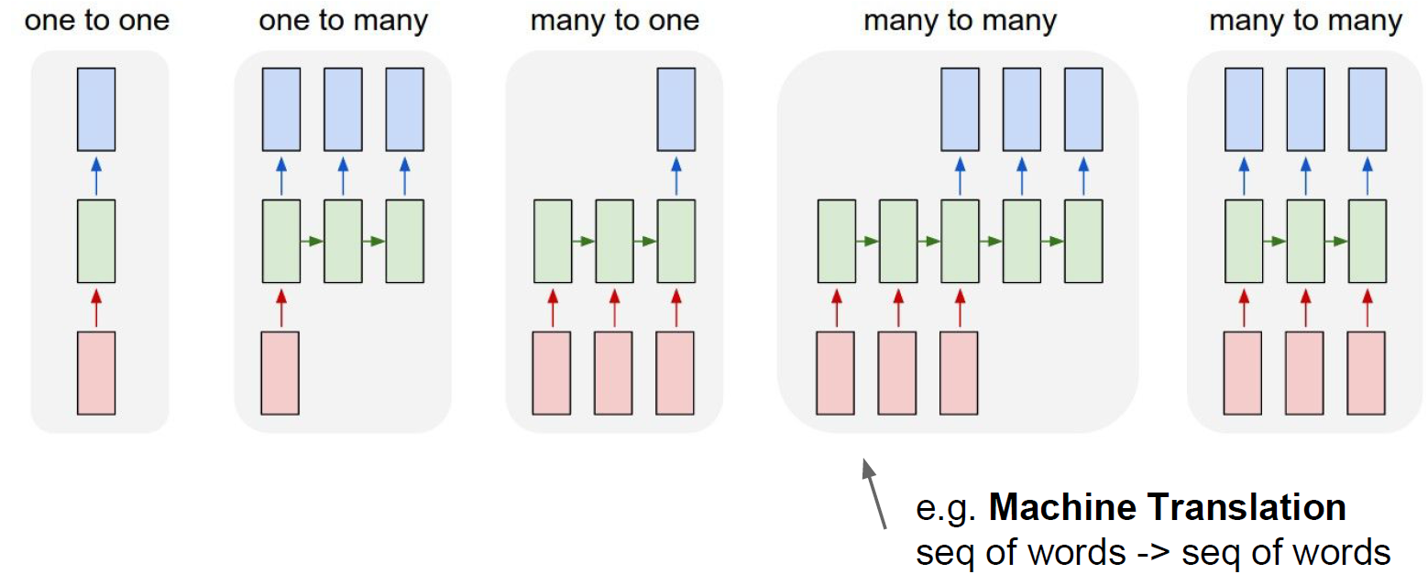
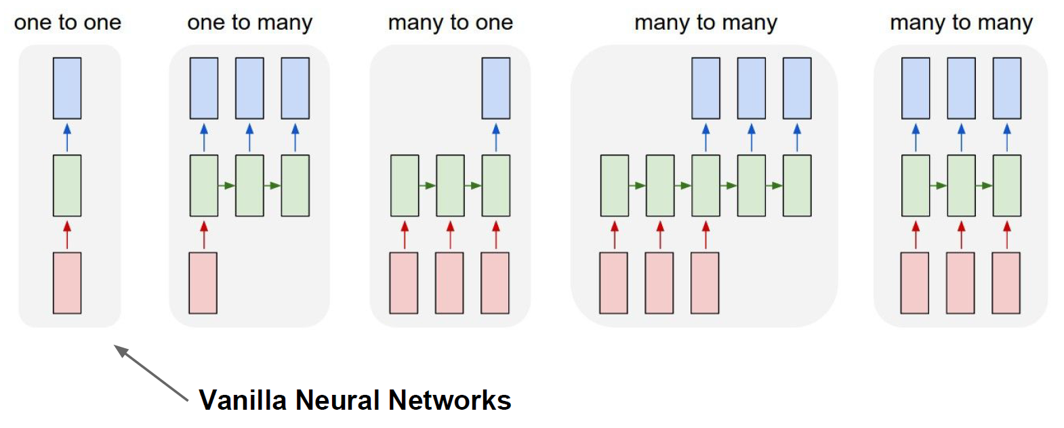
Recurrent Networks offer a lot of flexibility

Slide 20
Many-to-many case
x_{t+2}
U
V
… …
X_{t+1}
W
h_{t+3}
y_{t+3}
U
V
x_{t}
… …
W
h_{t+2}
U
V
y_{t+2}
W
… …
h_{t+1}
V
y_{t+1}
… …
h_{t}
y_{t}

